Slide 1




ASKSTOGA
CHATBOT
ANSWERS FOR CONESTOGA, 24/7
01

Slide 2




MEET OUR TEAM
BABANDEEP
HASYASHRI BHATT
PAULA RAMIREZ
TEAM-7
02

Slide 3


INTRODUCTION
Goal
Instant, accurate answers to student queries
Fewer tickets for front-desk staff
Easy to maintain and extend
Stack (at glance)
Streamlit → FastAPI → Retriever (MiniLM) → Embeddings (.pkl) + cosine similarity.
03

Slide 4



PROBLEM & OBJECTIVE
The Problem
Student Success Advisors at colleges are overwhelmed
Answers are scattered across policy PDFs and web pages
Long wait times and repetitive support questions
Objectives
24/7 self-service with cited sources
Reduce help-desk load and response time
Keep architecture simple, secure, and maintainable
04

Slide 5

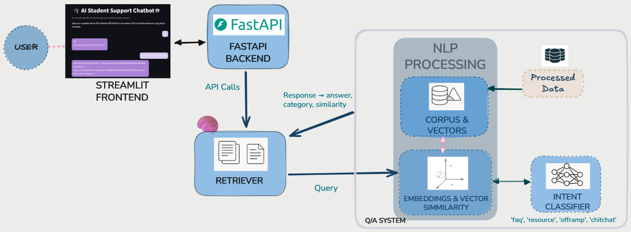
ARCHITECTURE (HIGH-LEVEL)
01
Student submits a question via Streamlit
02
FastAPI validates and forwards to retriever.py
03
Retriever embeds the query (MiniLM) and matches via cosine similarity
04
Intent Classifier predicts the query type
05
Final Response Generation
05

Slide 6
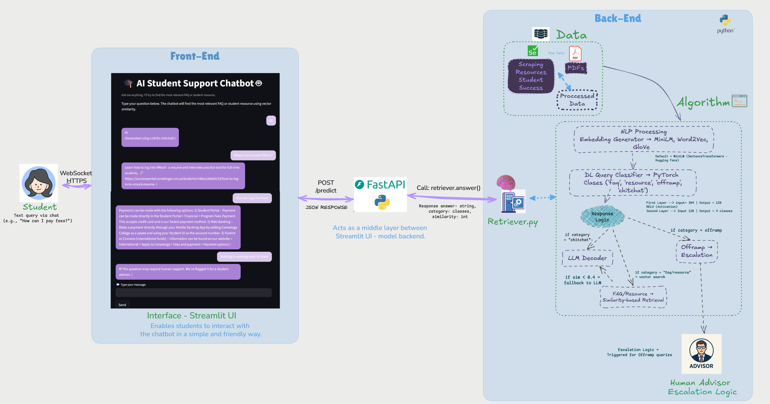
ARCHITECTURE IN DETAIL
07

Slide 7




DATA SOURCES
Student Success site (scraped resources)
With Selenium
Official PDFs (faq, policies, fees, procedures)
with pdfplumber
Processed into clean CSVs with page/section metadata where available
07

Slide 8
FRONTEND — STREAMLIT UI
Simple form for asking questions (basic validation)
Shows the best answer in plain text and Clickable links to official pages (when available)
UI → API via HTTPS JSON
08

Slide 9
API LAYER
(FASTAPI)
Endpoints: /predict
Validates payload (length/type) and rate-limits if needed
Calls retriever.answer() and returns JSON
Keeps API stateless; no session storage
09

Slide 10
NLP Processing: Embeddings & Semantic Matching
We tested 3 embedding methods: MiniLM (HuggingFace), Word2Vec (trained), and GloVe (pretrained). MiniLM showed the best semantic precision.
Cleans and normalizes corpus and query text (spaCy, ftfy)
Embeds both using MiniLM (384-dim vectors)
Embedding function via embedding_hf.py (encode_texts)
Stores corpus vectors in .pkl format for fast access
10

Slide 11
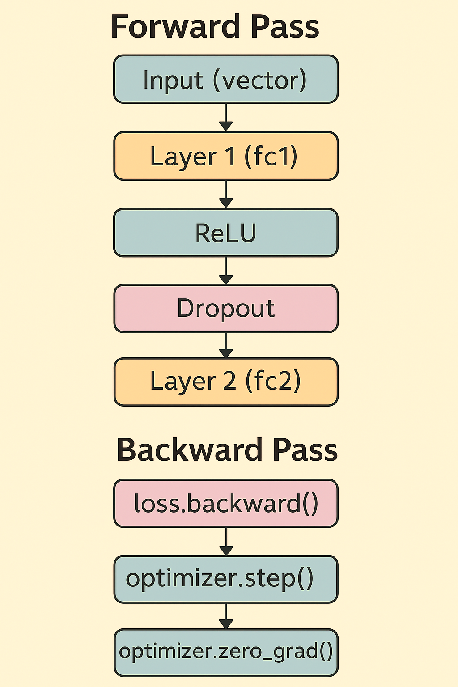


DL QUERY CLASSIFIER → PYTORCH
NEURAL NETWORK
Classifies student queries into 4 intents for routing
Training
Data: labeled queries from FAQs + curated paraphrases
Split: train/validation/test with early stopping
(Best model selected by validation loss)
11

Slide 12
ESCALATION & GUARDRAILS
RESPONSE LOGIC
It's the core function that decides how to respond to the student's query, based on its intent and similarity to known answers.
Receive class & Calculates cosine similarity between query and precomputed corpus vectors
Routing logic based on thresholds:
Similarity ≥ 0.8 + chitchat → return closest match directly
Similarity < 0.4 → fallback to LLM (e.g., OpenAI/GPT)
Intent = offramp → suggest contacting a human advisor
Intent = faq or resource with good match → return top result from corpus
10

Slide 13
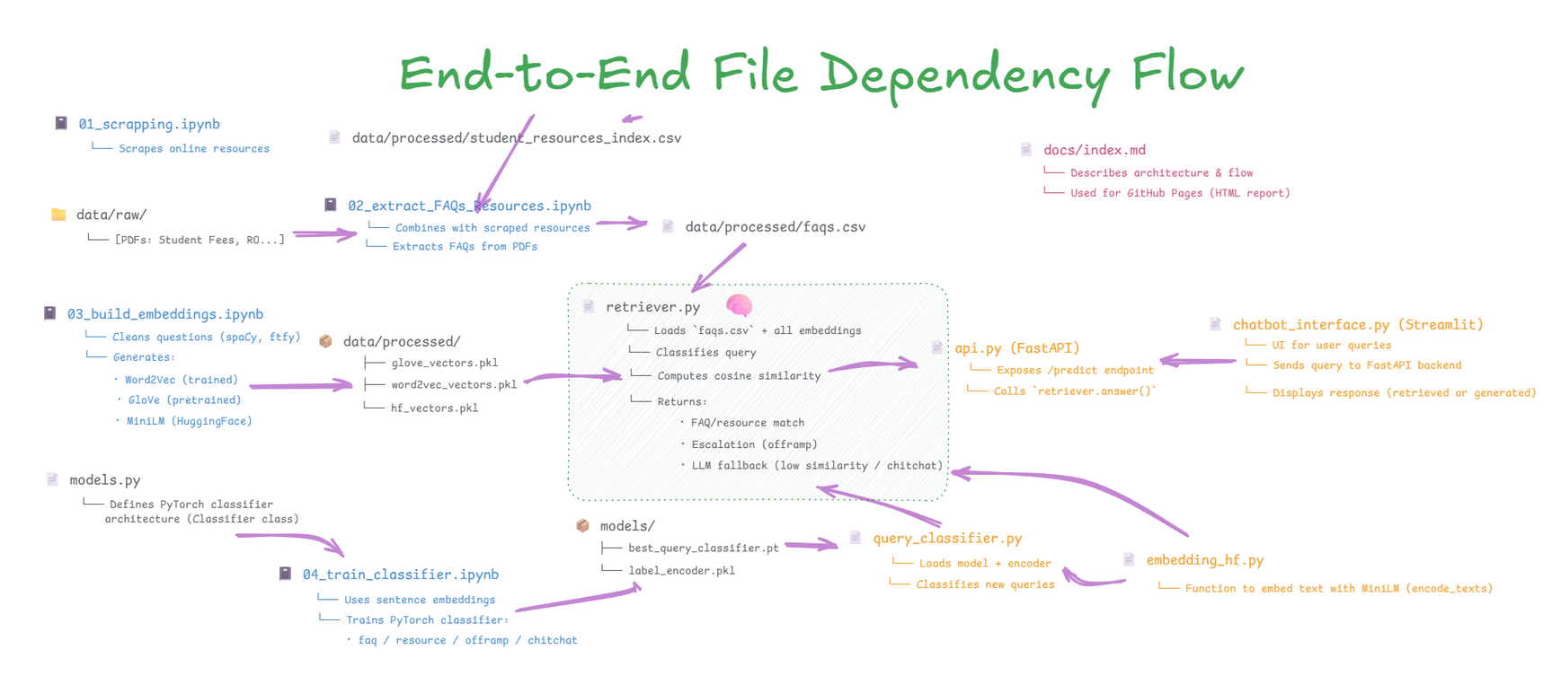
DATA PIPELINE
How Each Component Contributes to Answer Generation
Each file in our system plays a role in preparing data, training models, and generating intelligent responses.
12

Slide 14


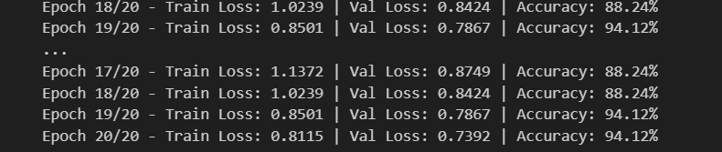
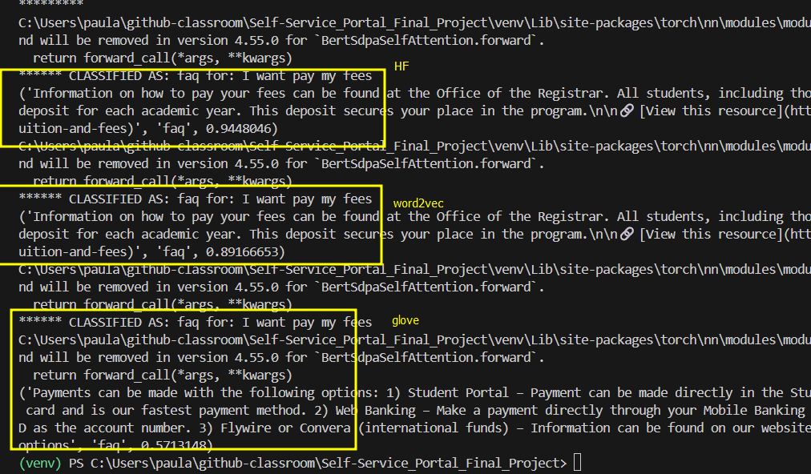
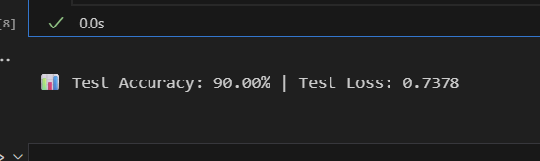
QUALITY & METRICS (LIGHTWEIGHT)
Latency: aim ≤ 2s per answer
Runs fast on CPU
Accuracy 90% | Loss 0.7378
Validation loss -> Early Stop
Train / Val / Test
Confidence -> Cosine Similarity
15
Notes:
Validation loss was used for early stopping to prevent overfitting.

Slide 15

DEMO FLOW
Open Streamlit, type “How can I pay fees?”
API receives JSON → retriever.answer()
Retriever returns best match + official link(s)
UI renders the answer and links
16

Slide 16
RELEVANCE AND IMPACT
Engineering Practices (Why it’s sustainable)
MLOps
Version Control: Git for code/notebooks/configs with PR reviews
Modular Structure: Streamlit ↔ FastAPI ↔ Retriever; swap embedding model or add LLM fallback without rewrites
Scalability: stateless FastAPI, precomputed .pkl embeddings, easy horizontal scale
Impact for Students & Staff
24/7 access to reliable answers from official sources
Response time for basic queries drops to seconds
Human advisors can focus on complex, emotional, or sensitive cases
Consistent information across channels
18

Slide 17

ROADMAP (THE FUTURE)
GPT fallback for low-match or chit-chat queries
One-click + scheduled embedding refresh
Re-ranking + multi-embeddings to boost accuracy
Multilingual support (detect & translate)
Conversation memory and advisor handoff in UI
19

Slide 18

IN SUMMARY
Built a chatbot to handle high-volume student queries with a modular NLP pipeline (classification + retrieval).
Evaluated GloVe, Word2Vec, and MiniLM — selected MiniLM for stronger semantic matches on our data.
Retrieval: MiniLM sentence embeddings saved to .pkl; cosine similarity returns the best match → UI shows answer + official links.
Smart routing (PyTorch classifier):
faq/resource → similarity-based retrieval
offramp → advise contacting a Human Advisor
chitchat / low match → basic reply for now
20

Slide 19
THANK YOU!

